Slide 1






Agho Fru & Katherine Halliday
Nov 29, 2023
BR41N_0V3RFL0W
MULTITHREADED SORTING: ENHANCING PERFORMANCE THROUGH CONCURRENCY
This presentation is optimized
for whiteboard use
Let's get started

Slide 2



AGENDA
Introduction
Project Overview and Design
Empirical Analysis and Findings
Summary

Slide 3

INTRODUCTION
What is Multi-Threading?
Technique to improve performance by using multiple execution units (threads) to solve different parts of a problem simultaneously.
Benefits:
Enhanced Performance: Faster execution of parallelizable tasks.
Challenges:
Thread Locking: Conflicts when multiple threads access the same resource.
Overhead: Resource cost in creating and deleting threads.
Parallelization Limits: Not all tasks are suitable for parallel processing.
Key Takeaway:
Powerful tool for performance improvement, but requires careful management and is dependent on task suitability.
Back to Agenda Page

Slide 4


Back to Agenda Page
WHY SORTING
Ubiquitous in Computing: Sorting is a fundamental operation in computer science.
Search Optimization: Essential for making search algorithms faster and more efficient.
Real-World Applications: Underpins functionality in databases, search engines, and data analysis.

Slide 5
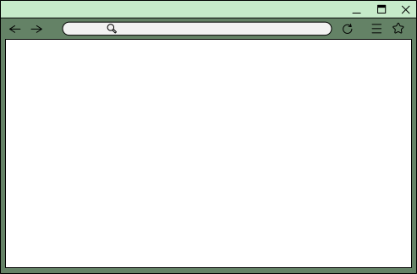


Project Design Overview: Assessing Multi-Threading on Sorting Algorithms
C++ Program: Executes each sorting algorithm 100 times.
Data Set: Uses an array of 10,000 statistically random numbers.
Multi-Threading Analysis: Measures performance impact when introducing multi-threading.

Slide 6
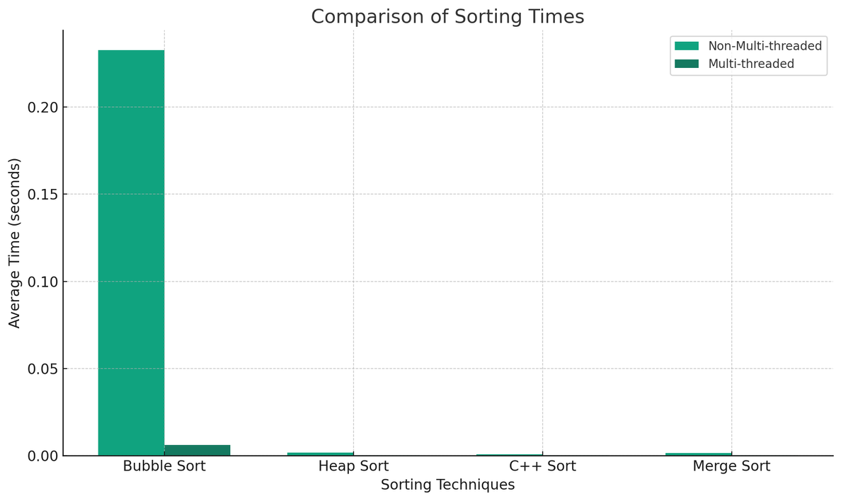

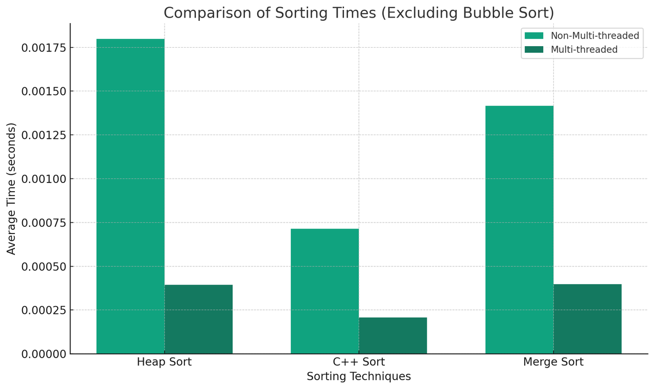
EMPIRICAL ANALYSIS AND FINDINGS
Impressive Speed Enhancements:
Bubble Sort: 97.40% Faster
Heap Sort: 78.11% Faster
C++ Standard Sort: 71.02% Faster
Merge Sort: 71.96% Faster
Multithreading Impact:
Divide & Conquer Algorithms Excel: Multithreading shows substantial gains in sorting methods that split and merge data.
Efficient Resource Utilization: Improved performance without linearly increasing resource use.
Innovation in Action:
Demonstrates the power of parallel computing in traditional algorithms.
Inspires new approaches to algorithm optimization.
Project Insight:
Multithreading isn't just a theoretical advantage—it's a practical solution to achieve breakthrough performance in computing tasks.
Back to Agenda Page

Slide 7
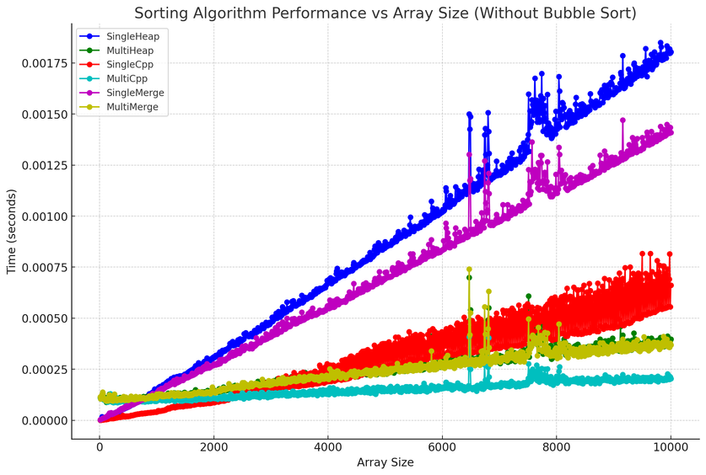
Back to Agenda Page
SUMMARY
Performance Enhancement:
Bubble Sort: Improved from 0.232541s to 0.00603821s.
Heap Sort: Improved from 0.00179738s to 0.000393358s.
C++ Sort: Improved from 0.000713135s to 0.000206649s.
Merge Sort: Improved from 0.00141612s to 0.000397101s.
Efficiency Gains:
Up to 38x speed improvement (Bubble Sort) with multithreading.
Significant efficiency boost without linear increase in resources.
Challenges and Considerations:
Variability: Not all algorithms experience the same level of improvement.
Structural Constraints: Algorithm design may limit parallelization benefits.
Problems With Small Datasets: When using small data sets multi-threading can actually be slower due to the overhead costs of threads.

